Slide 1
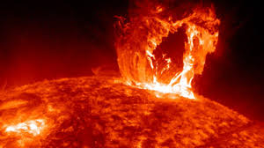
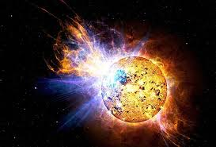
Solar Flare Apocalypse
Joe M, Kelsy R, Alyssa G, Devin B, Tori R

Slide 2
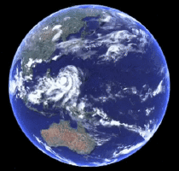
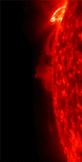
Details of Apocalypse
A solar flare has taken out all the power in Peru (where the group is located)
It has also damaged the ozone layer and has released a radiation into the air
Notes:
Alyssa read

Slide 3
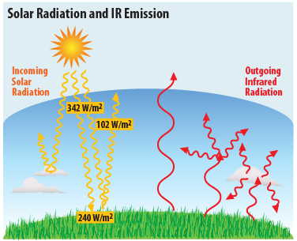
Details continued
Once the radiation enters a living organism's body they instantly break out into fifth degree burns and the body’s temperature will reach 101 degrees and it will increase if the body is exposed to sunlight for more than 25 minutes at a time
The amount of radiation that is entering the earth is 10 times the normal amount.
Notes:
Tori read

Slide 4

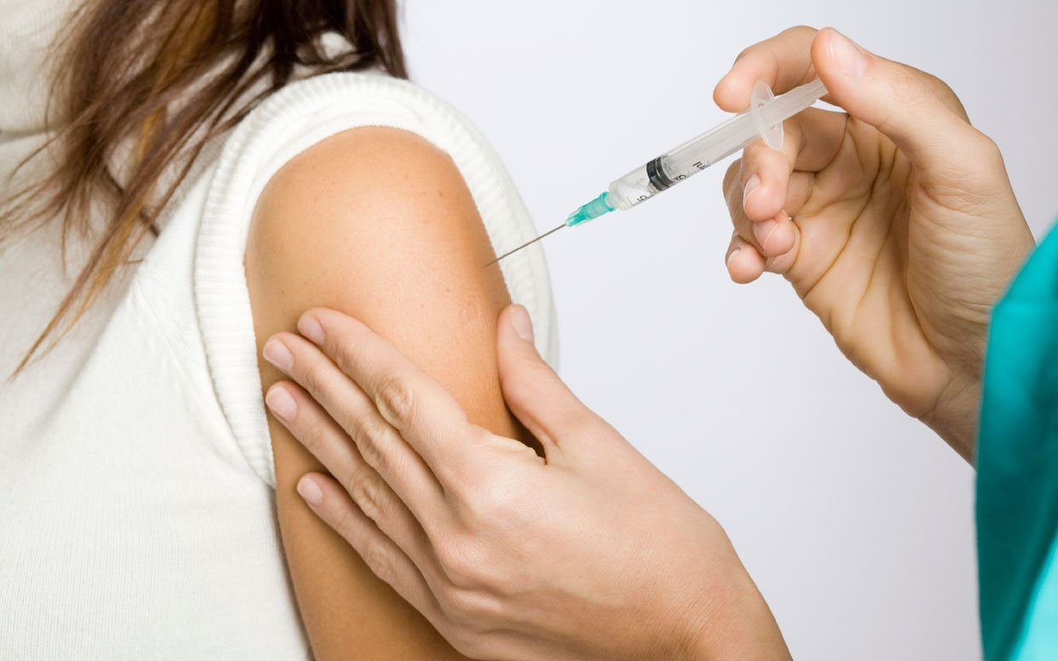
Details continued
Our goal is to find a type of cure whether its short term or long term.
If its short term then we would put it in sunscreen with at least SPF 100 and would reapply as needed.
Long term we would inject as a shot
Notes:
Devin read

Slide 5
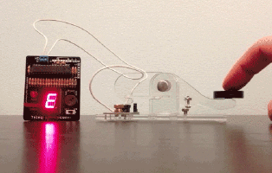
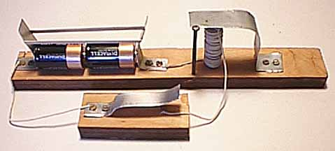
Communication
Tori will build two telegraph’s to demonstrate how to communicate with other communities without power
Notes:
Joe read

Slide 6
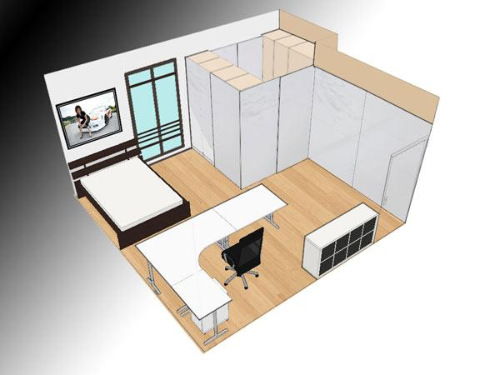
Engineering
Joe will create a model of our communication room online
This room will have windows that reflect the sunlight but allow us to see outside
Notes:
Tori read

Slide 7

Interpreter and Psychologist
Kelsy will be in charge of interpreting the messages sent through the telegraph in morse code. She also specializes in psychology.
Notes:
Kelsy read

Slide 8
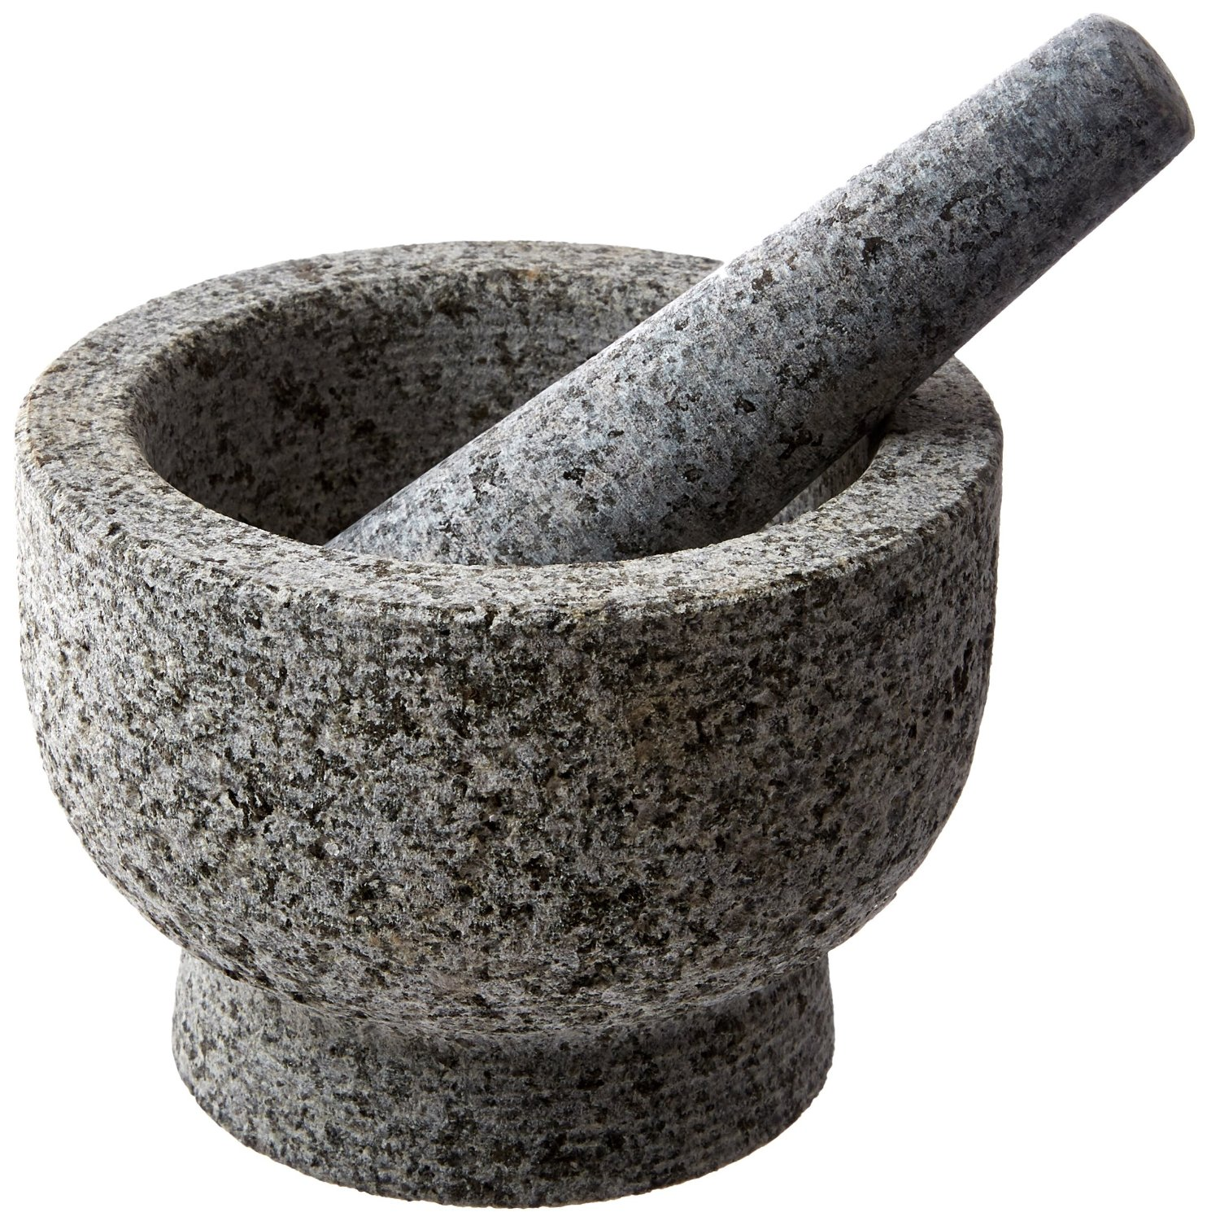
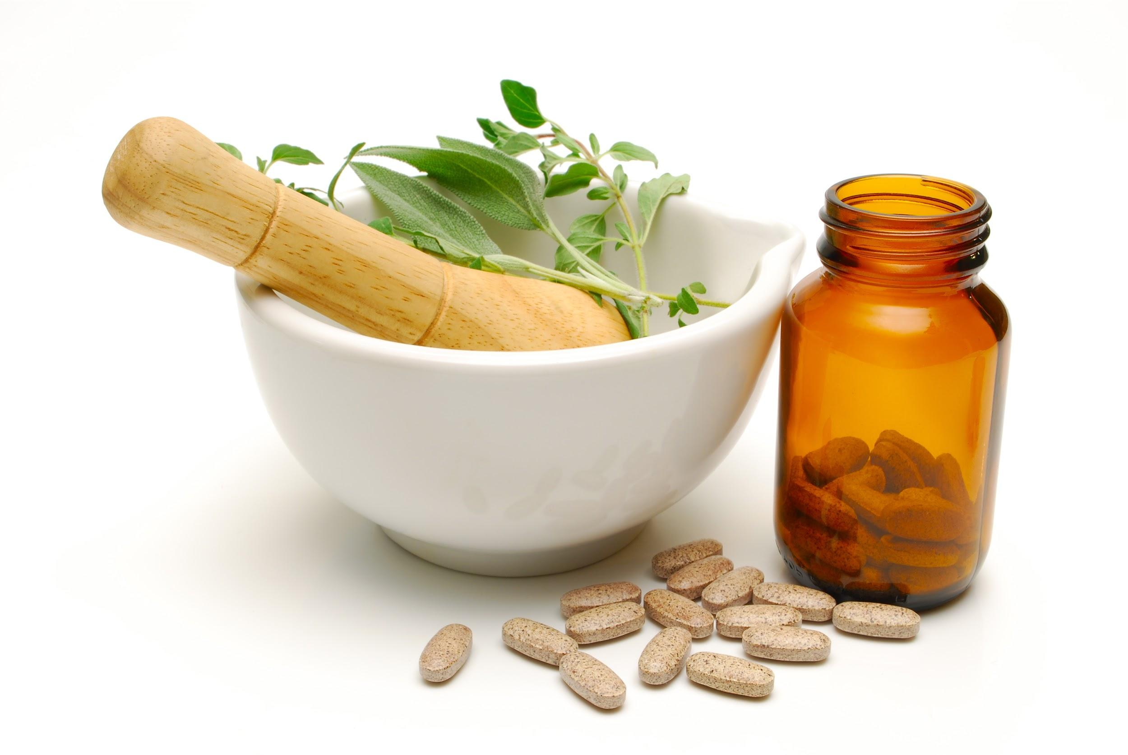
Medical
Alyssa is in charge of monitoring the effects of the radiation and aiding Devin in his work for working with natural herbs in a mortar and pestle
Notes:
Devin read

Slide 9

Final project
For our final project we will perform a skit to show how the two telegraphs will work
We will then have Kelsy interpret the code
She will then give the message to Alyssa and Devin who will then know what herbs to try to find the cure
Alyssa and Devin will mix the natural herbs in a mortar and pestle
Notes:
Alyssa read

